Slide 1
How is education investment reflected on key macroeconomic indicators?
Data Engineering I - Team 2
Alejandra Savage
Yahya Kocakale
Jesus Ibarra
Zunaira Pasha

Slide 2
TABLE OF CONTENTS
01
02
03
OBJECTIVE
METHODOLOGY
CONCLUSION

Slide 3
OUR OBJECTIVE
By compiling different public databases, we intend to unveil findings and present insights regarding the intricate interplay of socioeconomic factors that influence countries around the world.

Slide 4
DATA SOURCES
Dataset 2
RESULT
Dataset 1
Dataset 3
Country Insights and GDP per Capita
Mongo DB
Socio-Economic Metrics
Kaggle & AWS S3
World Bank’s API & GDP per Capita
World Bank
Combined relational database
* Data range from 2021 to 2023.

Slide 5
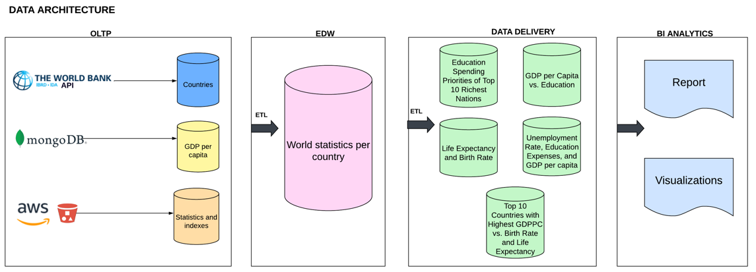
METHODOLOGY

Slide 6
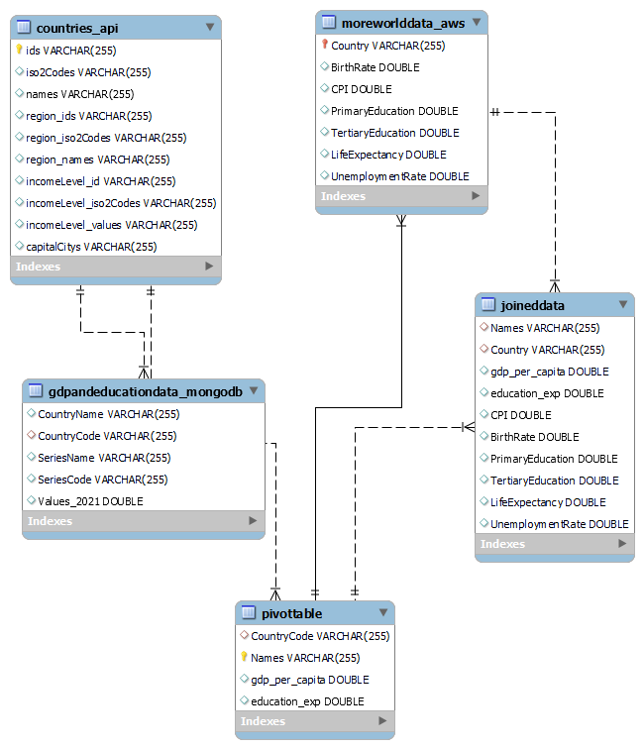
ERR DIAGRAM
The Enhanced-Entity-Relationship Diagram (ERR) diagram shows the primary keys.
Primary code was Country Code (VarChar).

Slide 7
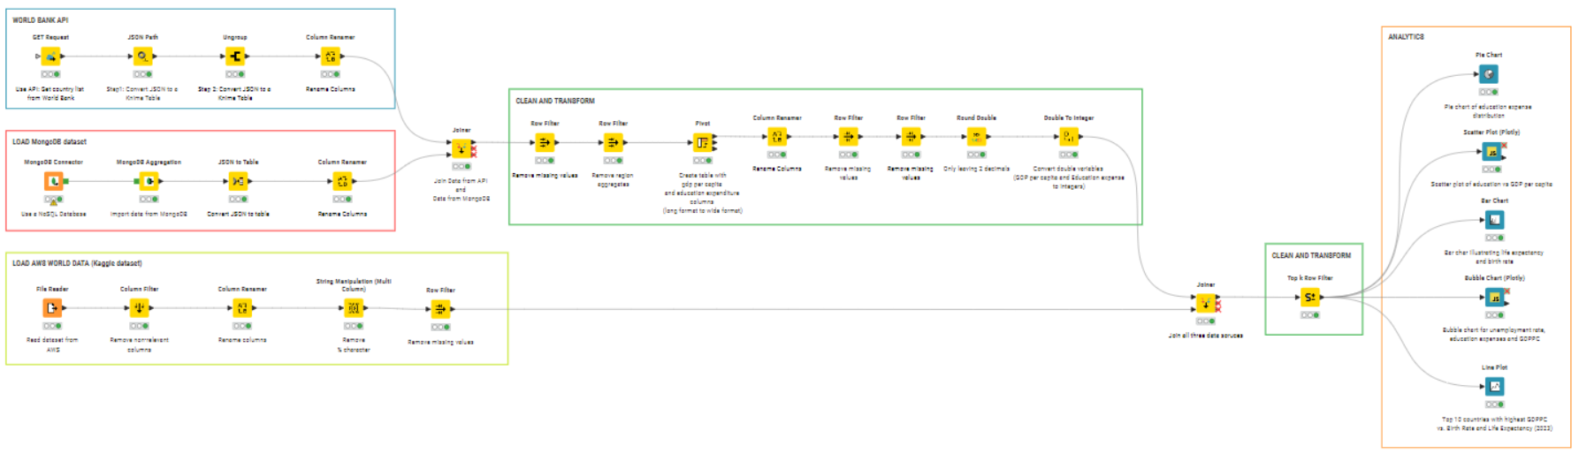
ETL & Knime Workflow

Slide 8
DATA INSIGHTS

Slide 9
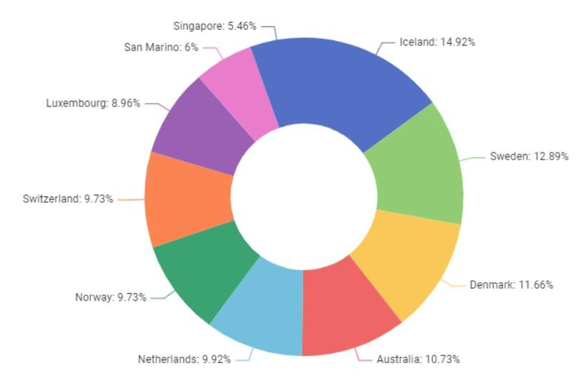
Education spending of 10 countries with highest GDP per capita

Slide 10
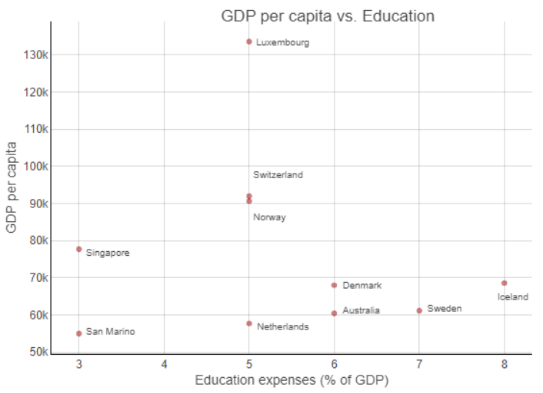
GDP Per capita vs Education Expenditure
Is possible to achieve high levels of economic development without spending the highest possible percentage of GDP on education.

Slide 11
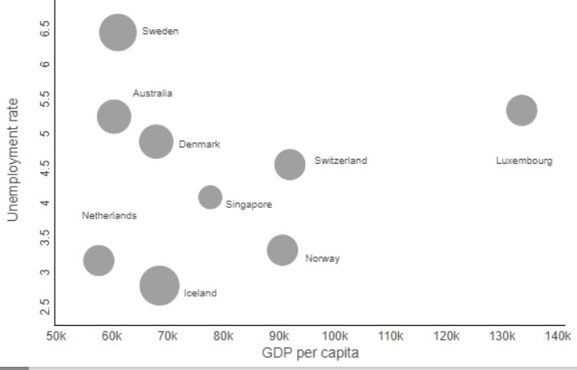
Link between Education, Unemployment and GDP per capita
This chart shows that unemployment levels and GDP per capita do not directly correlate to each other.

Slide 12
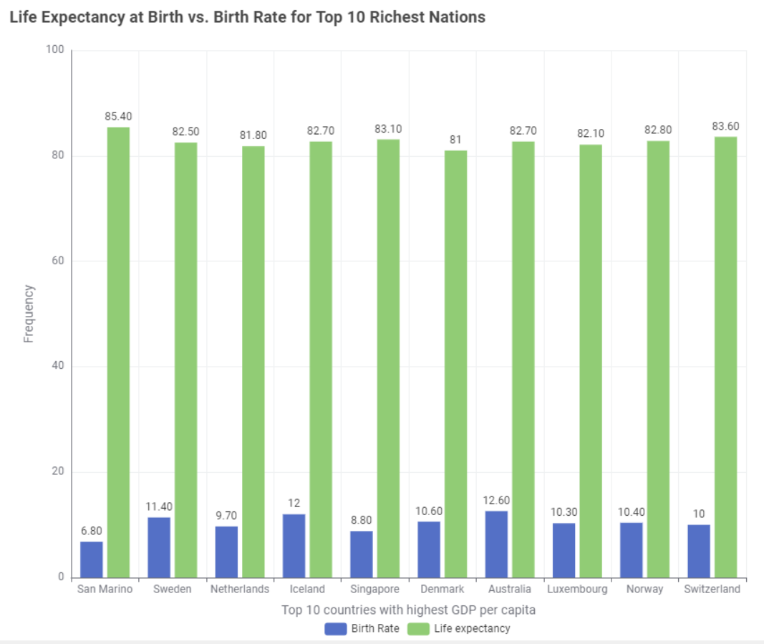
Education Expenditure vs Life Expectancy and Birth Rate
The graph shows a negative correlation between the two variables, meaning that countries with higher life expectancies tend to have lower birth rates.
Birth Rate
Life Expectancy

Slide 13
CONCLUSION
These discoveries highlight how important it is to invest smartly in education, health, and social and economic policies.
The importance of education as a driving force for socioeconomic development and highlighted the interconnectedness of various socioeconomic factors.
Data Engineering can help us understand complicated social issues.
With a robust data integration workflow we can integrated diverse datasets from public sources, assembling comprehensive economic, social, and educational indicators for analysis.

Slide 14
Thank you!
Data Engineering I - Team 2
Alejandra Savage
Yahya Kocakale
Jesus Ibarra
Zunaira Pasha

Slide 15
APPENDIX

Slide 16
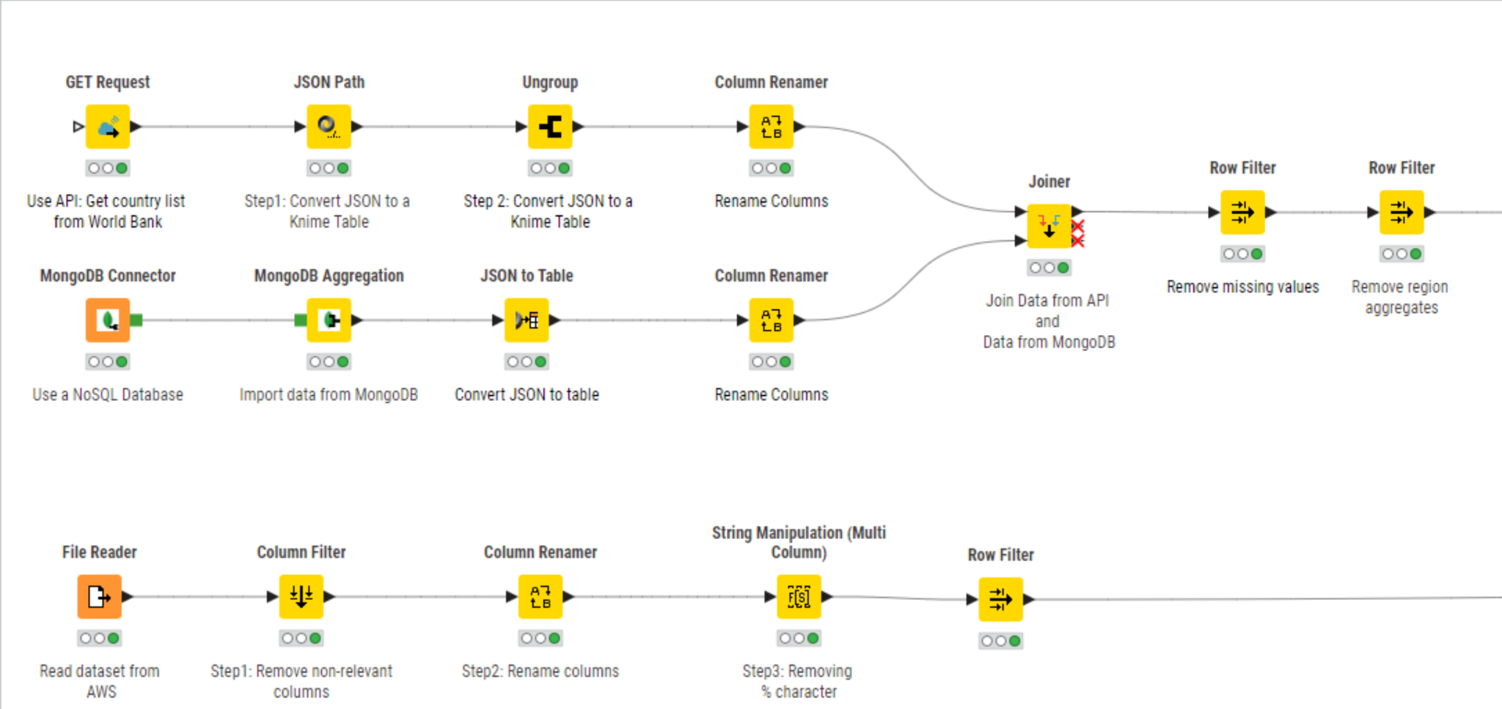
KNIME EXTRACT

Slide 17
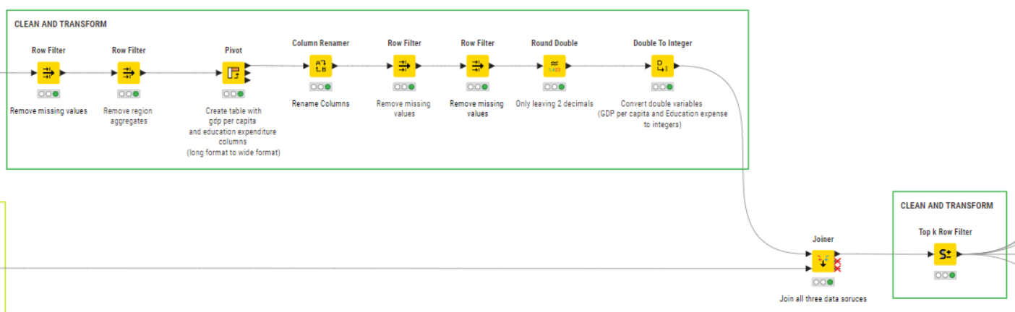
KNIME TRANSFORM

Slide 18
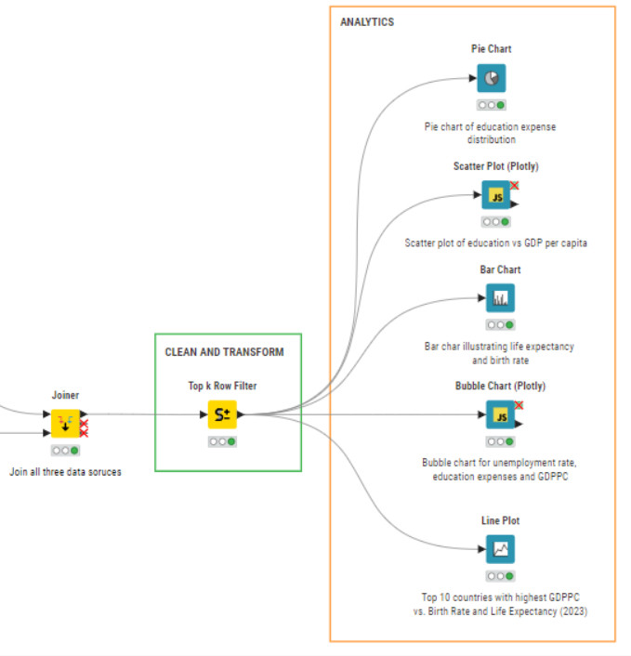
KNIME LOAD

